Slide 1
Jones Memorial Primary School
Primary 1 Applications
Caring Sharing Preparing Together

Slide 2
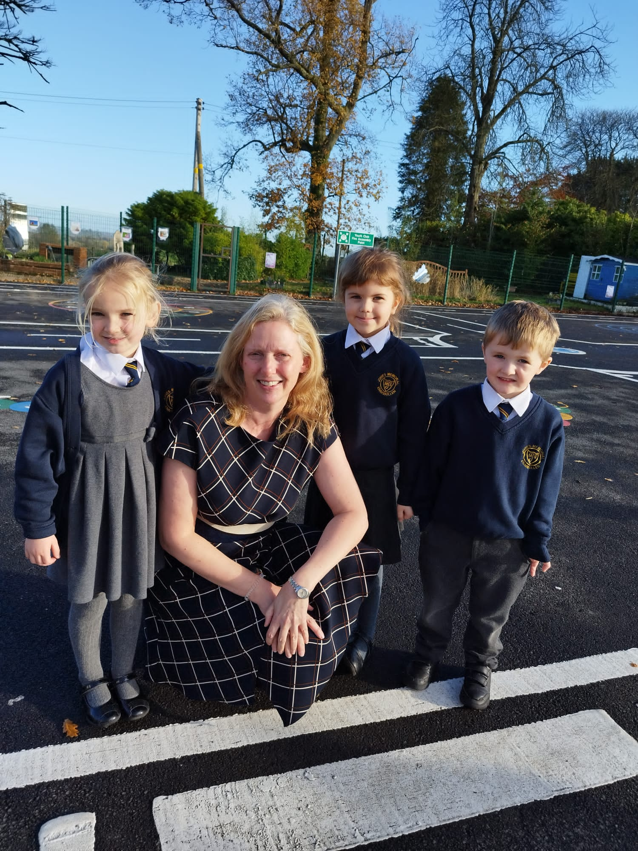
Principals Welcome!
Dear Parents/Guardians
It is a pleasure to present to you Jones Memorial Primary School and Reception Class prospectus.
Our pupils are at the heart of everything we do- staff seek to provide children with a happy and secure atmosphere in which to learn and develop their unique talents. We are a happy school and blessed with pupils who are motivated and
enthusiastic about all aspects of their school life.
Jones Memorial Primary School is well established in the local community. We have a strong and rich tradition of high standards of pupil attainment and conduct - this is reflected in the high expectations of all members of staff.
I hope that by reading this prospectus you will feel assured that your child’s time at JMPS will not only be rewarding and successful bur above all happy. All staff provide a caring environment in which your child can grow physically, spiritually, morally and emotionally as well as academically.
As much as this prospectus will give you an overview of life in Jones Memorial Primary School, you can only fully appreciate what we do by actually visiting us.
Please feel free to make an appointment by ringing the school on 028 66323420.
I would very much look forward to showing you and your child around our school.
Yours sincerely
Sandra Isherwood
Principal

Slide 3
Our Mission in our JMPS Family…
We have a moral purpose in Jones Memorial Primary; every single one of our pupils are special to us. We value their unique personalities, talents and what they bring to our school. We aim to nurture their love of learning, their belief in themselves and to have faith in the adults around them. We strive to make sure every child succeeds, constantly raising the bar, doing things better. We know and care for our pupils and families. We are here to support and do the utmost for our pupils, we are a Models Paths school– putting respectful, nurturing relationships at the heart of our school… that is what makes JMPS a unique, special place.
We aim for our parents and teachers to work together to support our pupils through a shared vision underpinned by effective leadership.
Pupils
Shared Vision
Teachers
Parents
Leadership
Caring, Sharing, Preparing Together

Slide 4
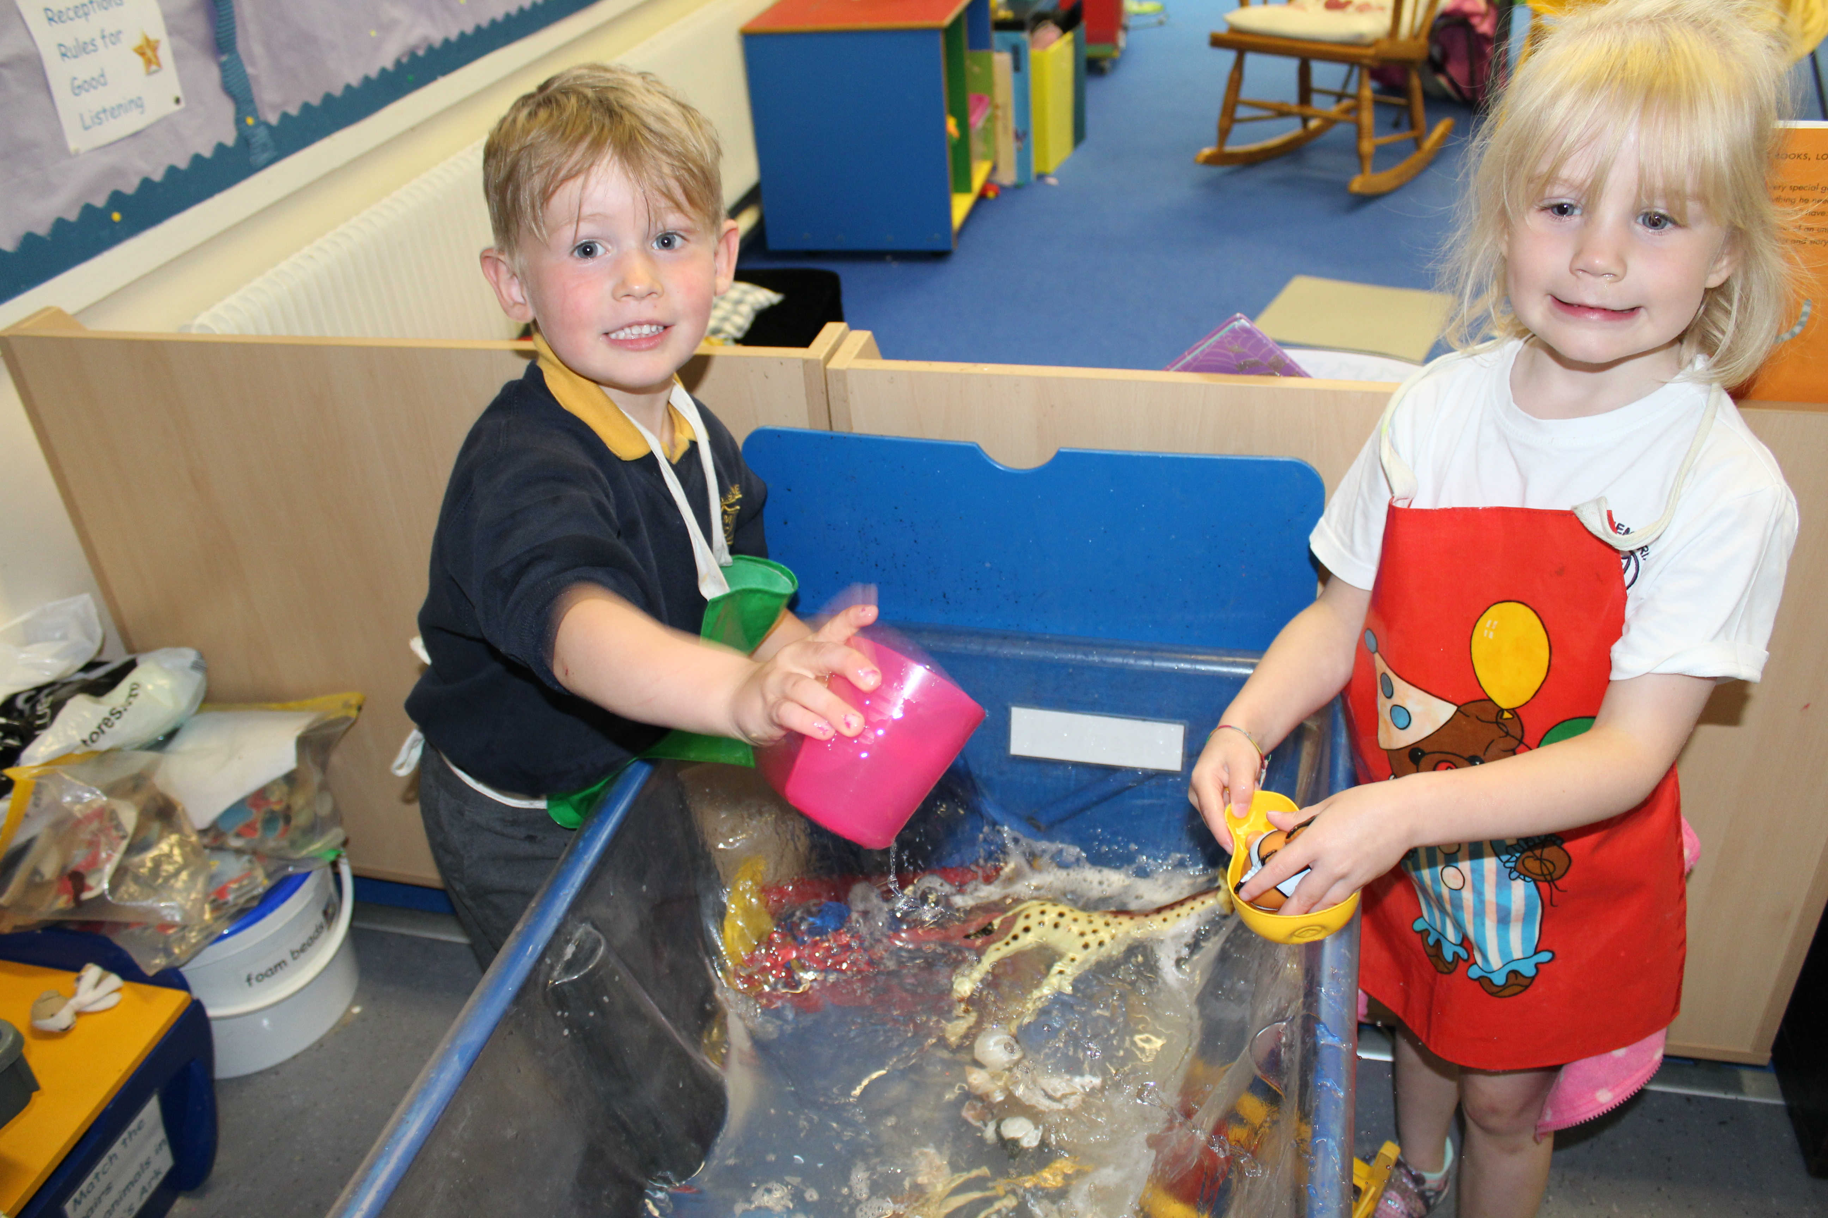
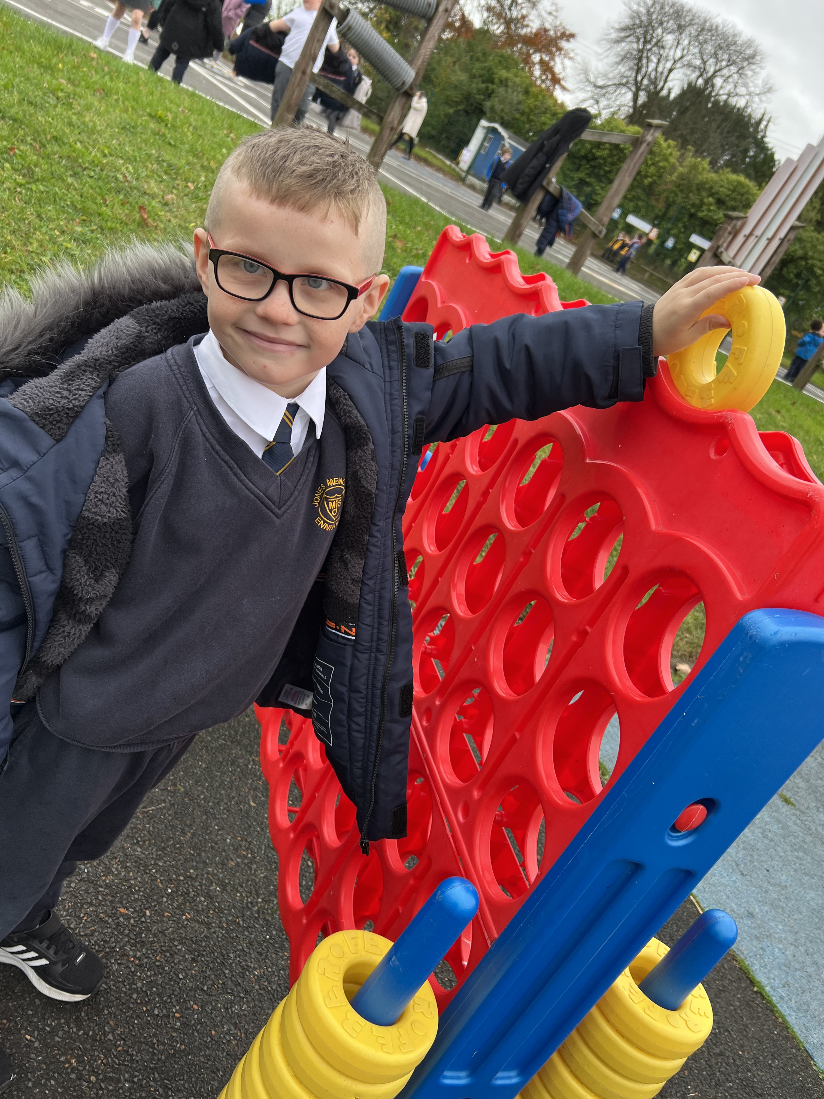
Some background information…
Inclusive ethos in our school
141 pupils
Primary 1-7 (1 class in each year
group)
NO COMPOSITE CLASSES
1 Job share in Reception
2 specialist classes (ASD & LSC) and a LSC
We work, where appropriate, with a range
of external agencies e.g. RISENI & Aisling Centre
Average class size of 22 pupils
Admission number of 29 pupils per year

Slide 5
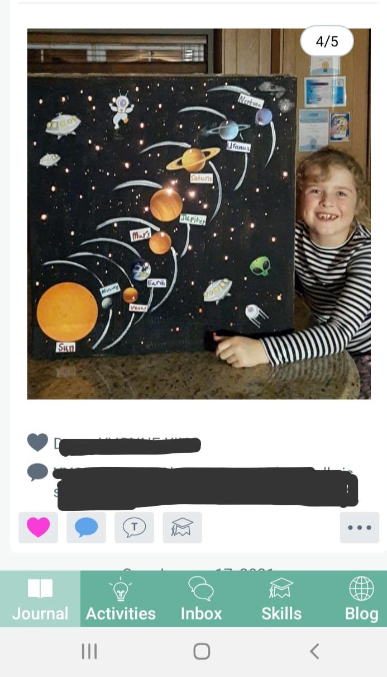
Communicating with you…
See-Saw App
School Email
Website
Monthly Newsletter
Facebook Account
Twitter
Instagram
Texting Service
Notes home…

Slide 6
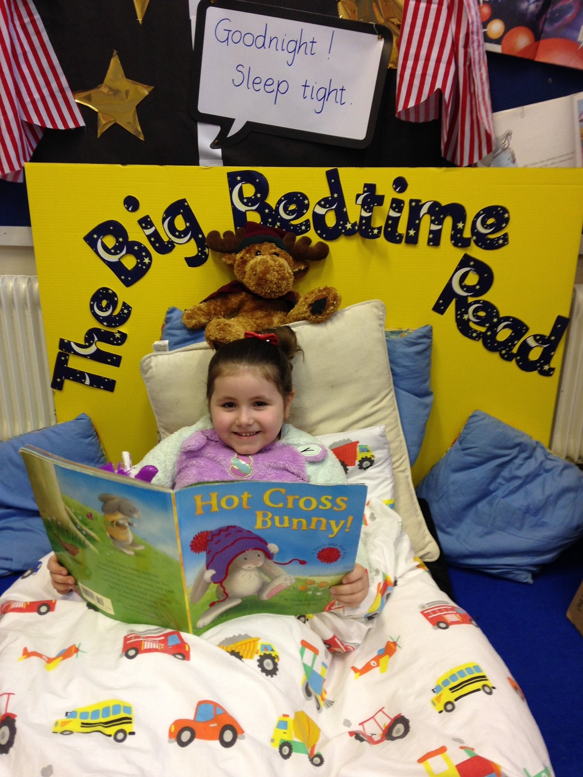
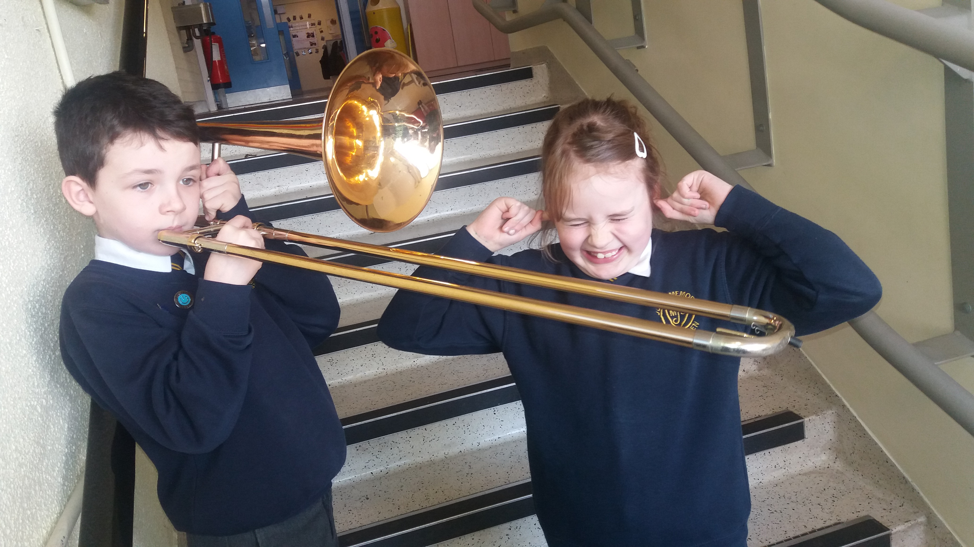
What is Primary 1 like?
Reassuringly, there are many similarities between P1 and the Reception setting…
In addition, we focus on …
Fostering nurturing, supportive relationships with our children as a Model PATHS school
Establishing JMPS as a safe, caring and structured place to be
Inspiring a love of being in school and embracing a natural curiosity about the world around them
Learning through Play
Additional Support Staff and Teachers
Close links with parents
Make MUCH effort to get to KNOW your child

Slide 7
Transitions to Primary 1…
We have developed excellent relationships with local nurseries / playgroups helping with…
A smooth and seamless transition from the Nursery setting in to Primary 1
Sharing of vital information e.g. progress to date, like and dislikes, strengths and areas of development (we start to get to know our children BEFORE they enter P1)
Friendship groups… which children in the Nursery setting have started to make those special, lifelong friendships? How can we in the Primary school nurture this?
Pastoral Care and family support

Slide 8
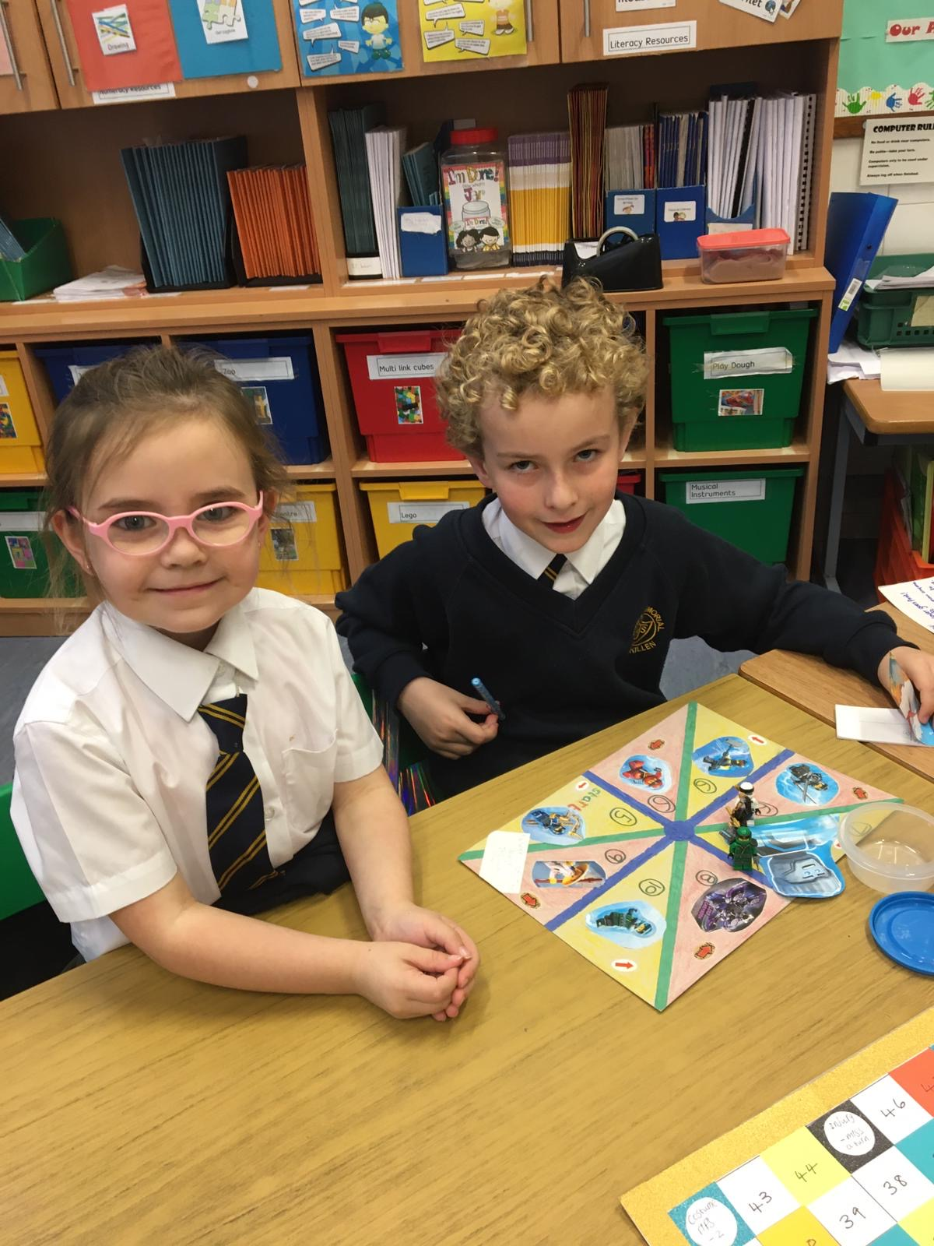
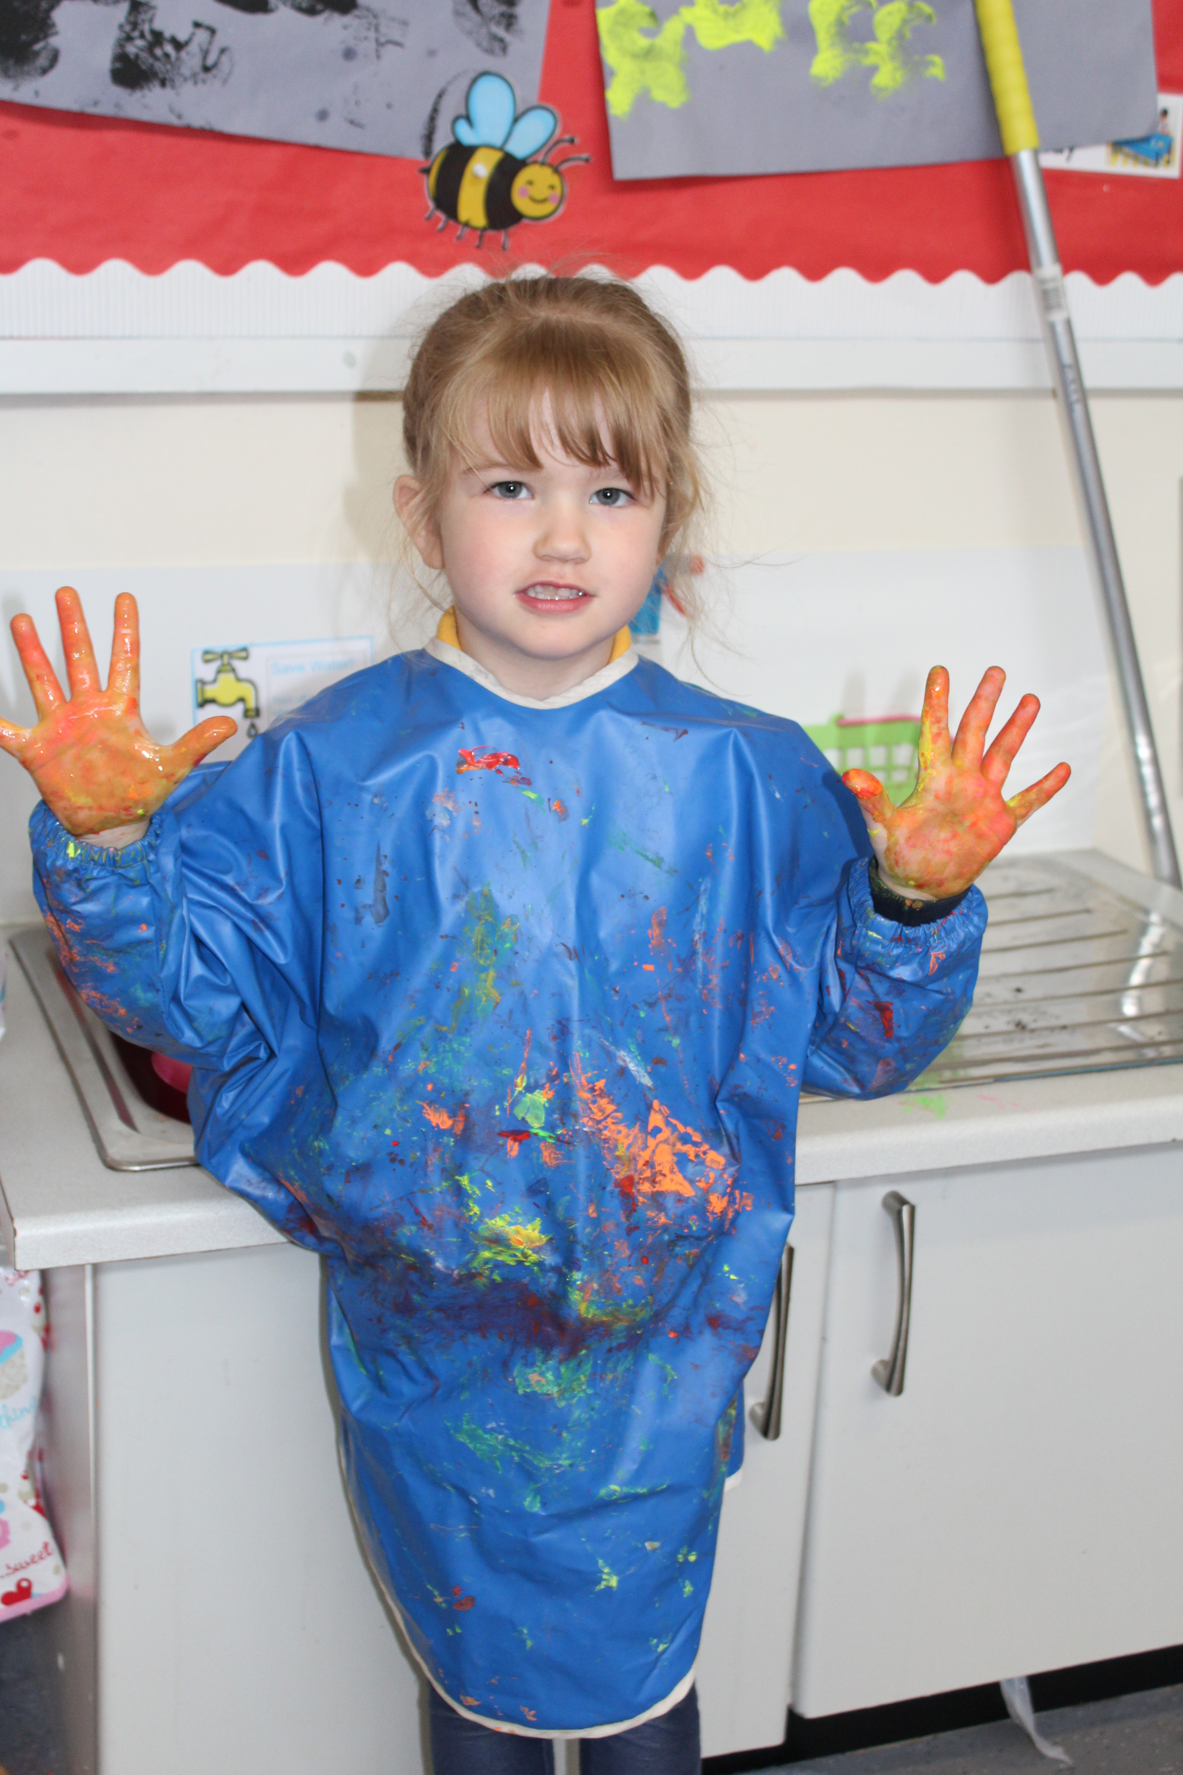
Extra Curricular Activities & Wrap Around Care
In Jones Memorial PS we offer a range of extra curricular activities (from early to late) meaning we offer Wrap Around Care.
Breakfast Club: 8:15 am
Buttercup (Rec & P1) 1.20 – 3.15pm
After School Club: 3.15 – 5pm
Professional Coaches & Music Tuition
Other Clubs are FREE OF CHARGE including…
Football | Rugby | ICT & Coding
Bug Club | Drama | Eco Club
Art & Craft | Cycling | Cookery
Scripture/ Bible Club | Choir | First Communion

Slide 9
Educational Visits, Residential & Shared Ed…
Pupils in JMPS benefit from a range of Educational visits and children from P6-7 enjoy a residential visits.
These include…
P1 – The Farm
P2 – The Garden Centre
P3 – Folk Park
P4 – Armagh Planetarium
P5 – Waterways Ireland
P6 – Stem Centre
P7 –Residential i.e. Edinburgh / Manchester
Shared Education
We are an inclusive school and pride ourselves on valuing everyone equally – respect & diversity is part of our strength.
From 2016 Jones Memorial PS has accessed additional funding to support our Extended schools initiatives with our partner schools in the Fermanagh Cluster.
From 2017 JMPS has accessed resources through CASE (Peace4) with our partner school Holy Trinity.

Slide 10
AQE & Transfer on from JMPS
Post Primary Feeder Schools
Devenish College | Enniskillen Royal Grammar School
Fivemiletown College | St Michaels
Mount Lourdes | St Josephs
St Francheas | Erne Integrated College
JMPS works to prepare pupils for AQE & GL Tests
Assessment results are used to assist with planning
ALL children, regardless of ability, are supported to reach their potential

Slide 11
Important Dates…
TUESDAY 10th January 2023 – Online Primary 1 Application Procedure opens on EA website with online portal available
Friday 27TH January 2023 – Online portal closes at 12 noon (all applications received after this date will be treated as late)
February 2023 – Supporting documentation and birth certificate must be with JMPS
– JMPS will select pupils at first preference stage
April 2023– Jones Memorial Primary School will write to successful & unsuccessful applicants
May 2023 – Final date for the receipt of appeals

Slide 12
Admissions Criteria…
ADMISSIONS CRITERIA – YEAR 1/RECEPTION
During the admissions procedure when applying the criteria punctual applications will be considered before late applications are considered. The application procedure opens on 10 January 2023 at 12noon (GMT) and an application submitted by the closing date of 27 January 2023 at 12noon (GMT) will be treated as a punctual application. An application received after 12noon (GMT) on 27 January 2023 will be treated as a late application.
Children of compulsory school age living within the traditional catchment area of the school.
Children of compulsory school age who have brothers/sisters or half-brothers/half-sisters presently enrolled at the school.
Children of compulsory school age regarded by the Board of Governors, on the basis of written or other evidence supplied by the parents/guardians and statutory or other agencies, as having special circumstances, (i.e. medical, social or security reasons).
Other children of compulsory school age.
Children aged 4 will be admitted into reception on their 4th birthday where there are vacant places within the admissions number.
The school will continue to admit children not of compulsory school age as above, unless the Department determines that such children will be zero rated for funding purposes.
The Board of Governors including the Principal draws up the Admissions Criteria and applies them if necessary.

Slide 13
How to join our Family…
Complete and return our Pre-enrolment application form. Available on ringing the school office.
From 10.01.23 online applications for Primary 1 may be completed on EA website. Paper application forms will also be available and the school office will offer support.
Applications CLOSE at 12.00 noon on 27.01.23.
Bring a copy of your child’s birth certificate to school ASAP along with supporting documents e.g. utility bill for proof of address.

Slide 14
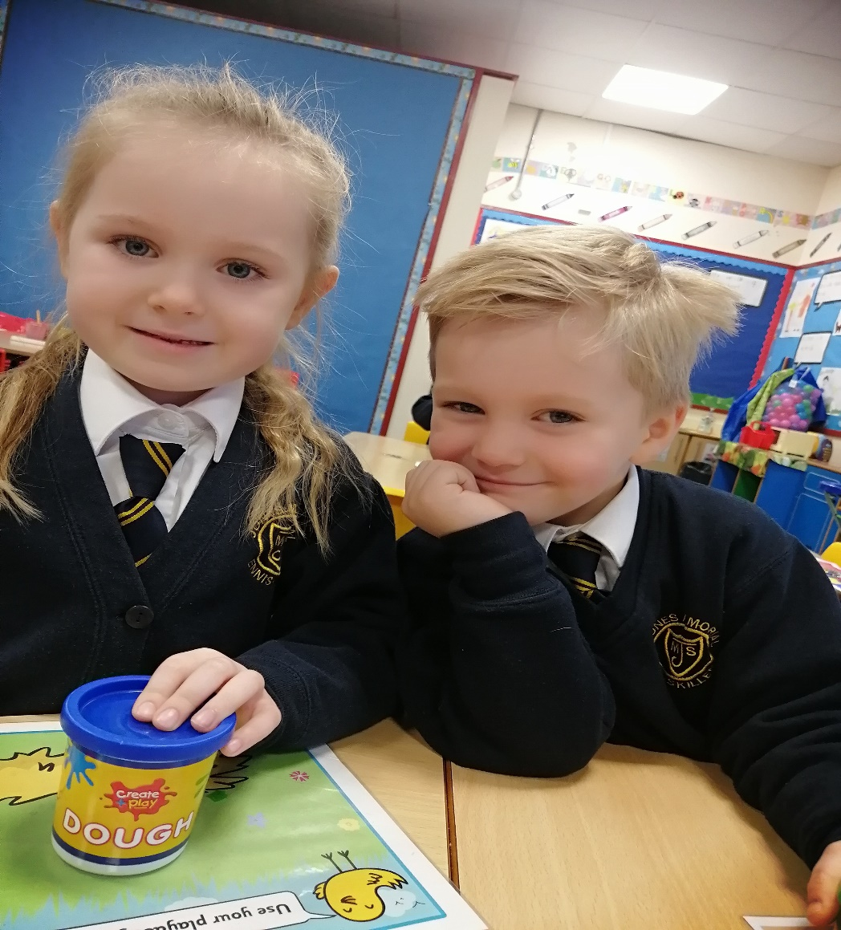
Would you like to visit school?
Get a “feel” of our ethos
Ask questions… email
info@jonesmemorial.Enniskillen.ni.sch.uk
Visit the web site and fill out an expression of interest
www.jonesmemorial.co.uk
Education Authority, Online Application portal will be available to accept P1 applications

Slide 15
And finally…
Please take some time to enjoy seeing round our school through our virtual tour… you may book a 1-1 visit to school… please visit our website to book
www.jonesmemorial.co.uk
Watch a variety of videos on our social media to get at a true feel of the school
Please complete the P1 Pre-enrolment form
We will send you a link to the official application.

Slide 16
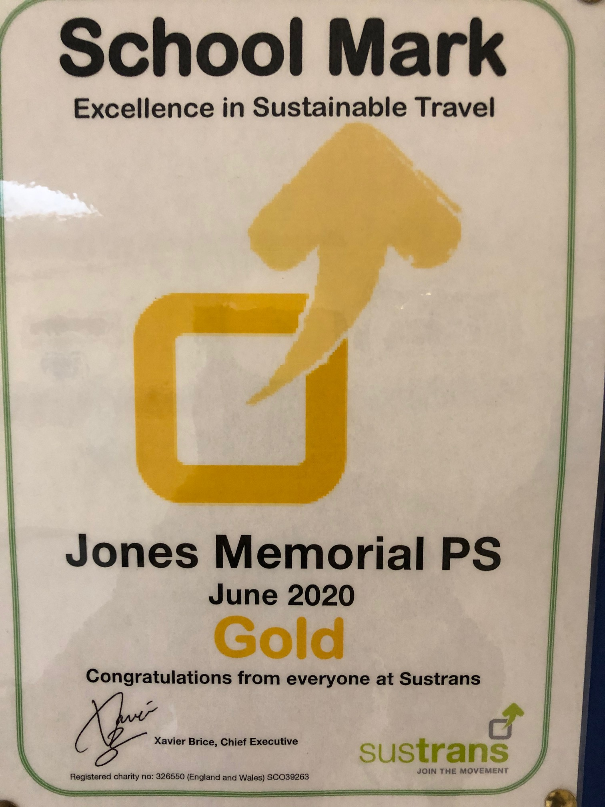
Thank you!
Gold Health Action Award

